Slide 2
F2F +170 (CAVI)

Slide 3
01.
One year before the European elections 2024
02.
Life in the EU : Democracy and the standard of living
03.
Citizens’ perception of the EU and the European Parliament

Slide 4
01.
One year before the European elections 2024
4

Slide 8
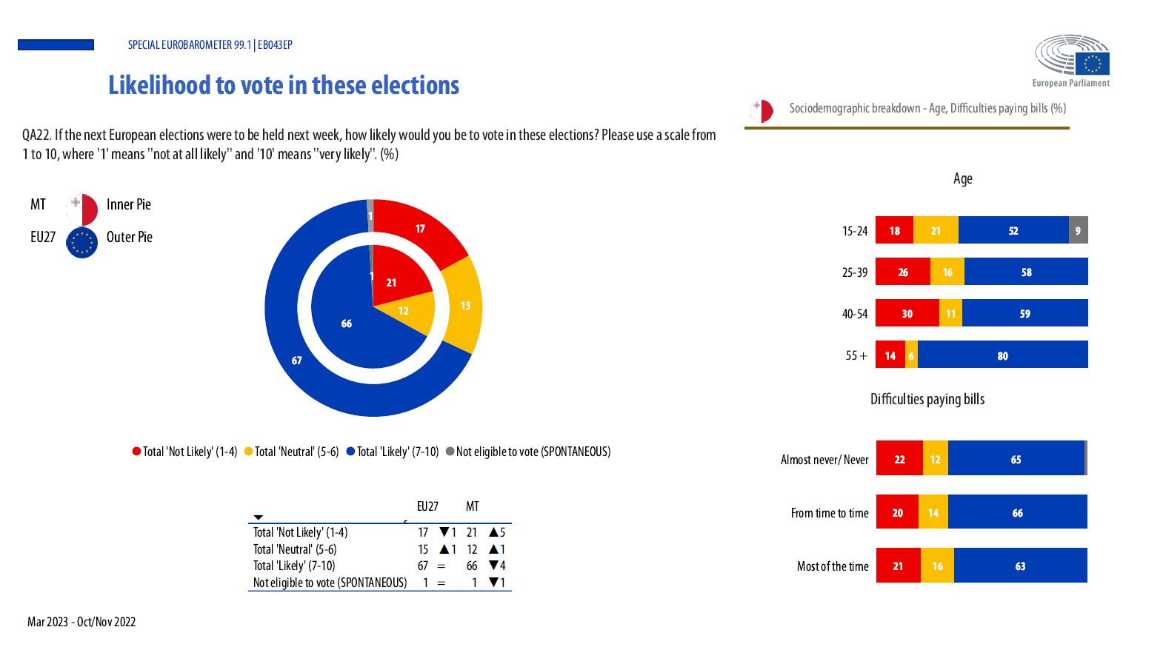

Slide 9
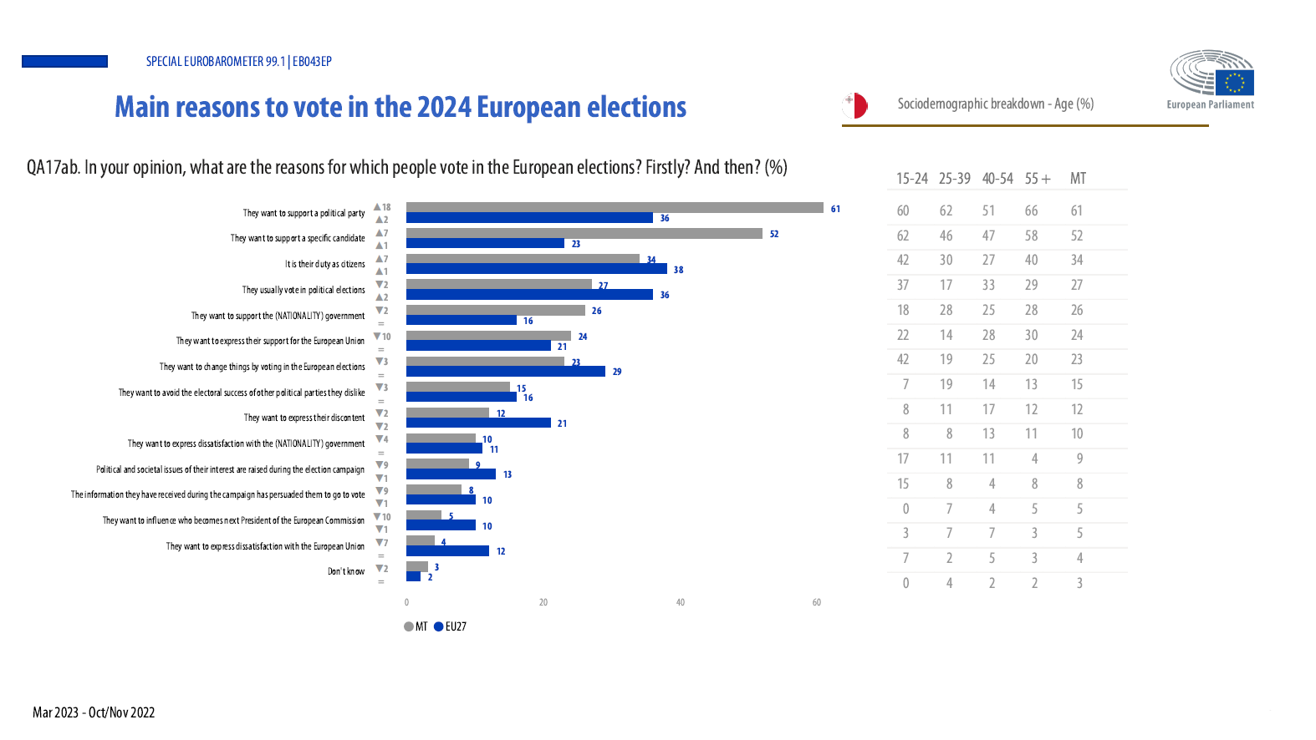

Slide 11
02.
Life in the EU : Democracy
and the standard of living
4

Slide 12
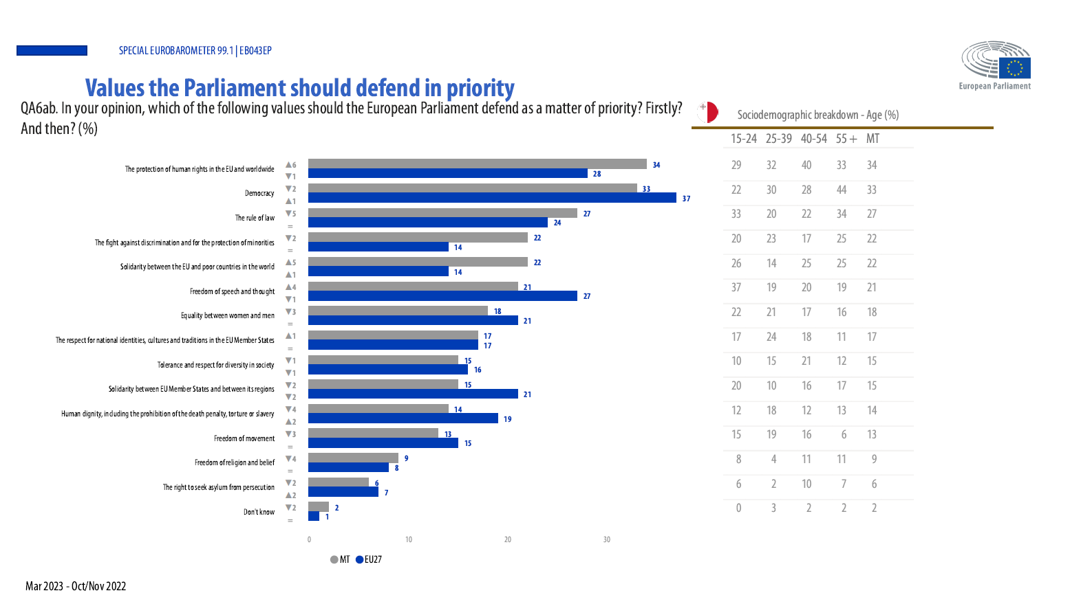

Slide 14
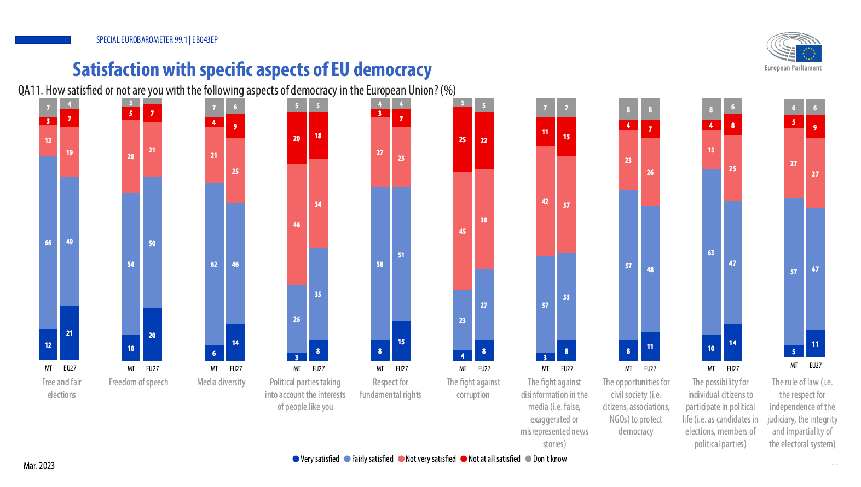

Slide 15
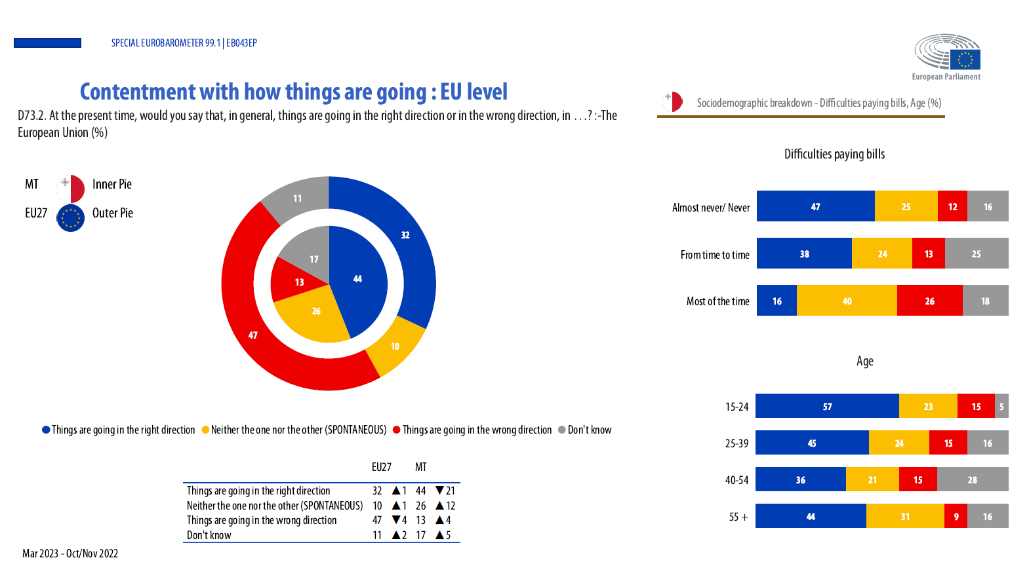

Slide 16
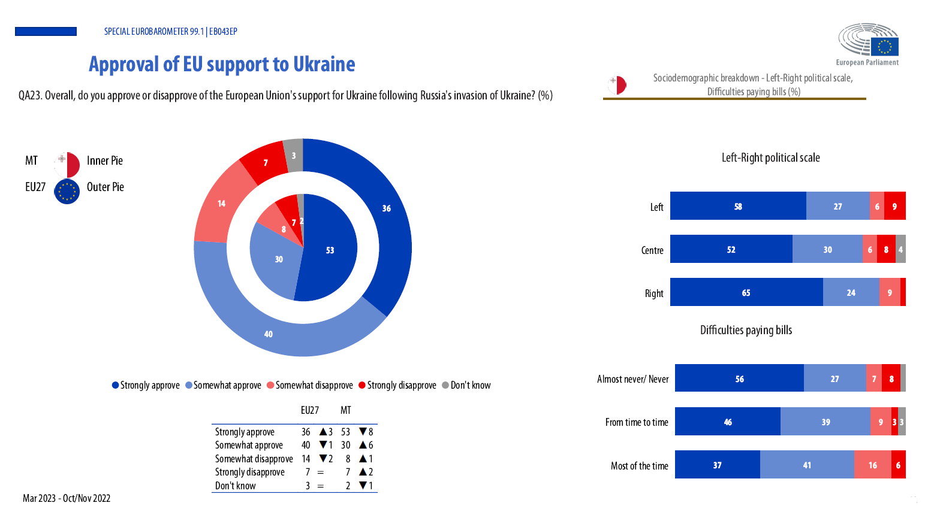

Slide 20
03.
4
Citizens’ perception of the EU and the European Parliament

Slide 21
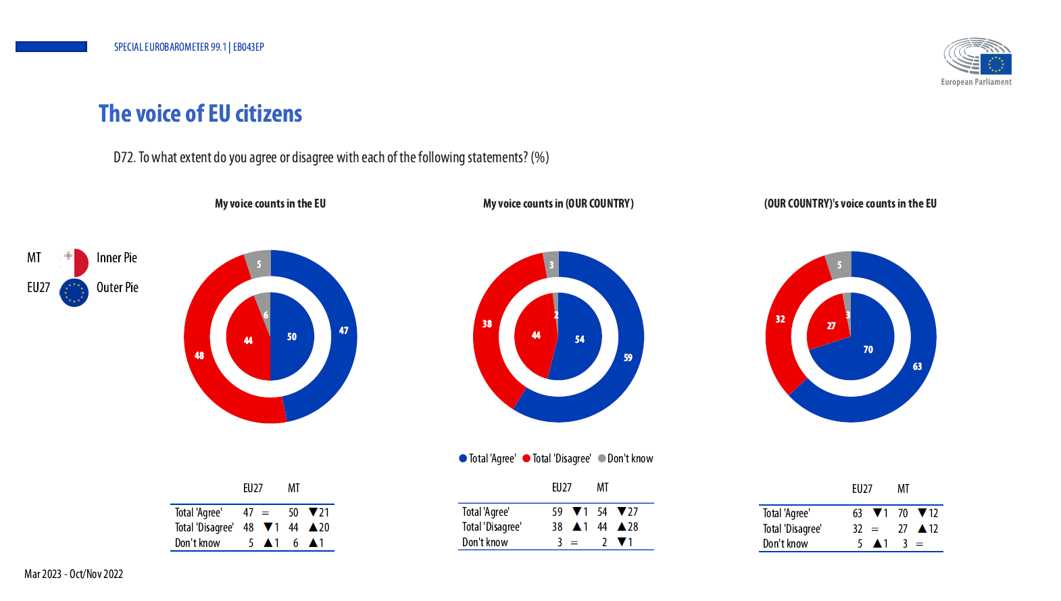

Slide 22
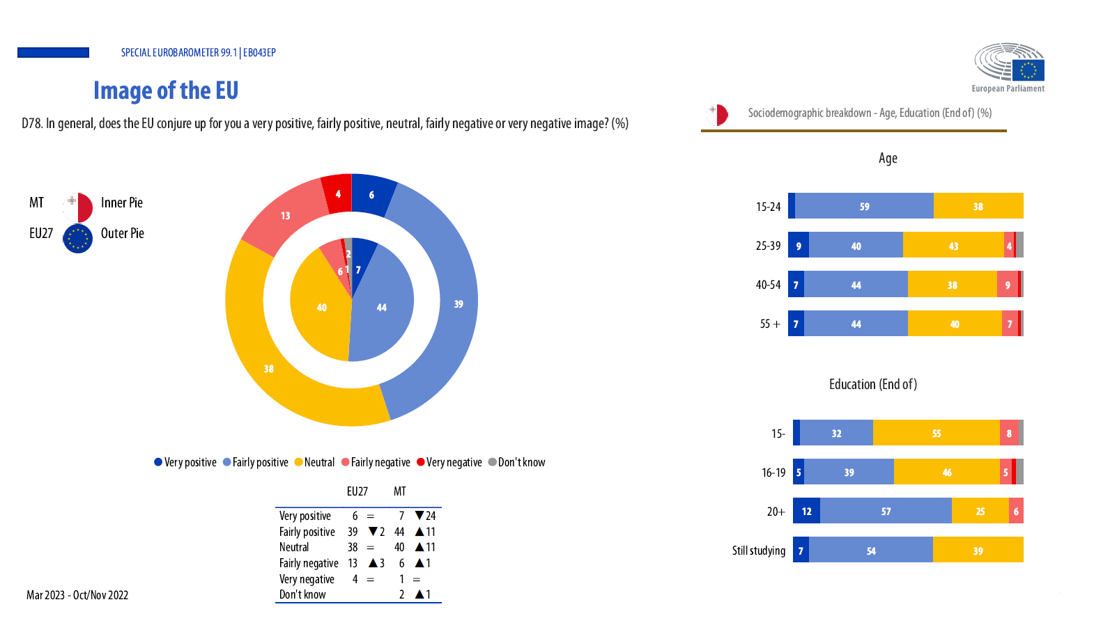

Slide 23
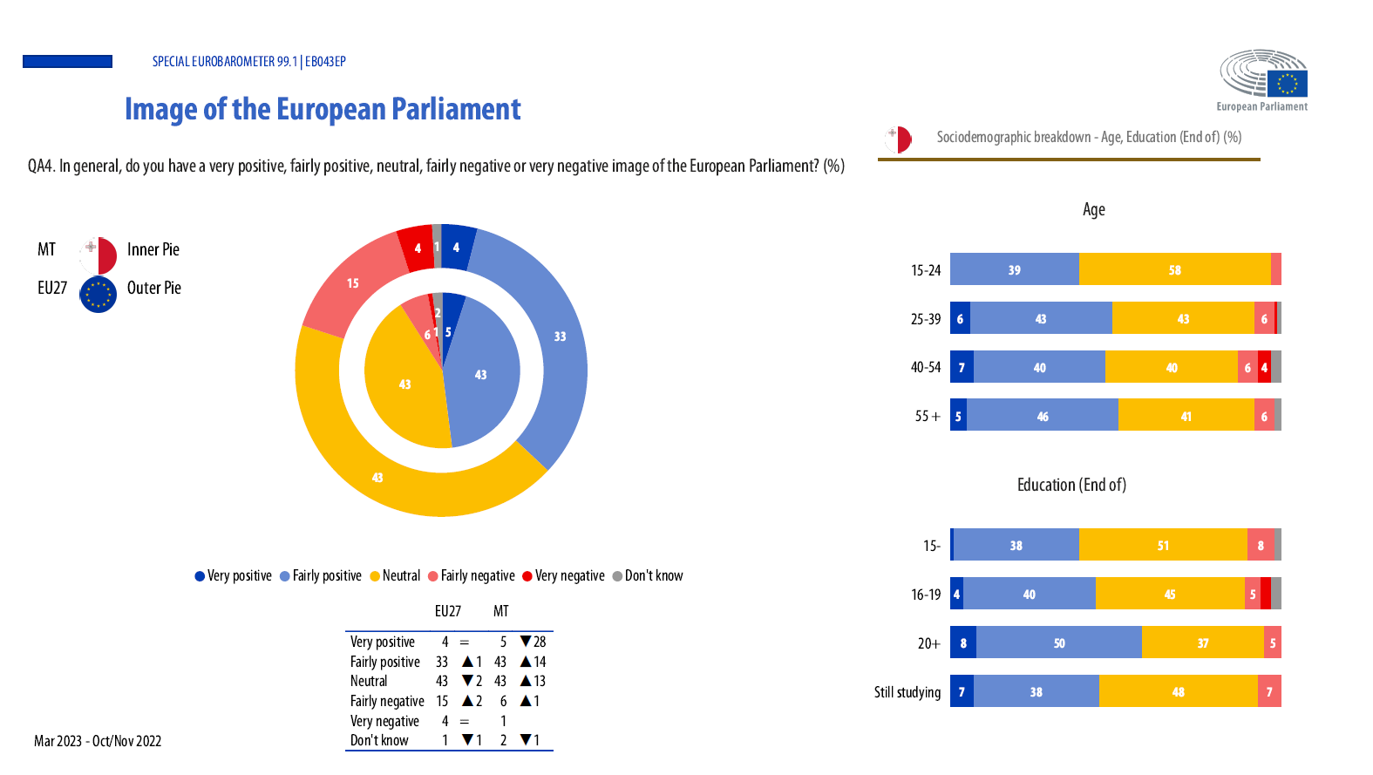

Slide 26
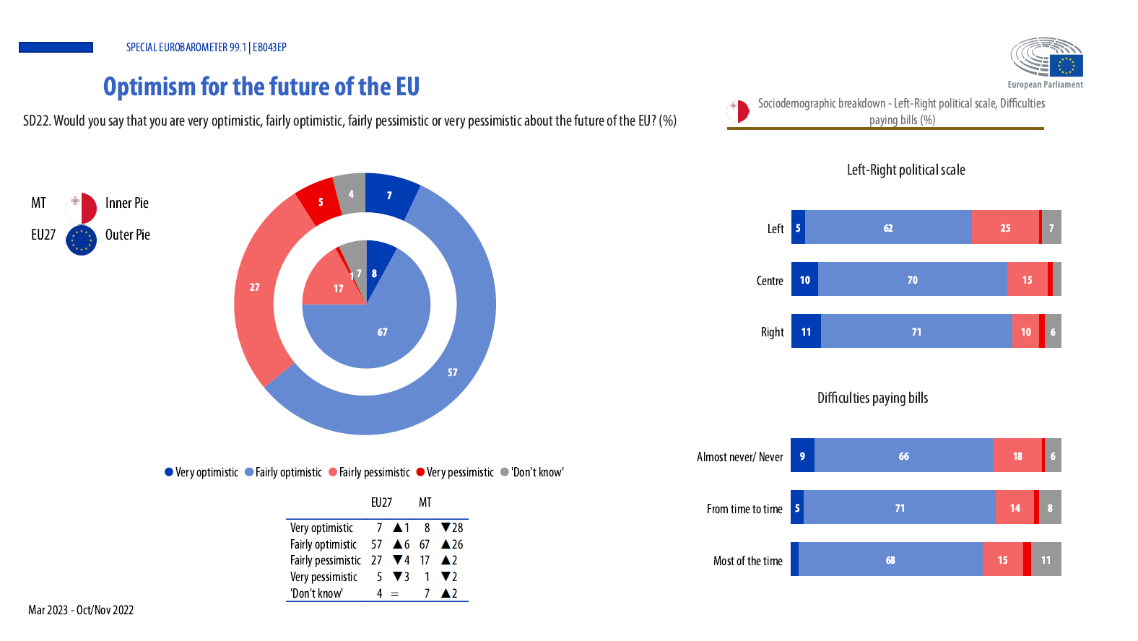

Slide 27
